Slide 1

HELLO WORLD!

Slide 2

FRIENDLY NEIGHBORHOOD GOKUL

Slide 3


Slide 4
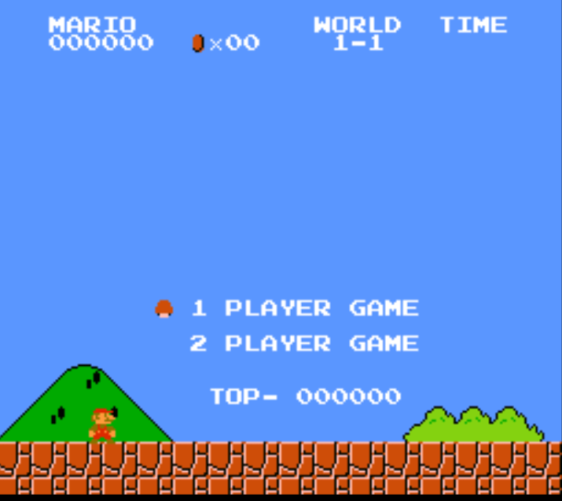

Slide 5

FIND THE COMMON WORD!

Slide 6
ELASTIC

Slide 7
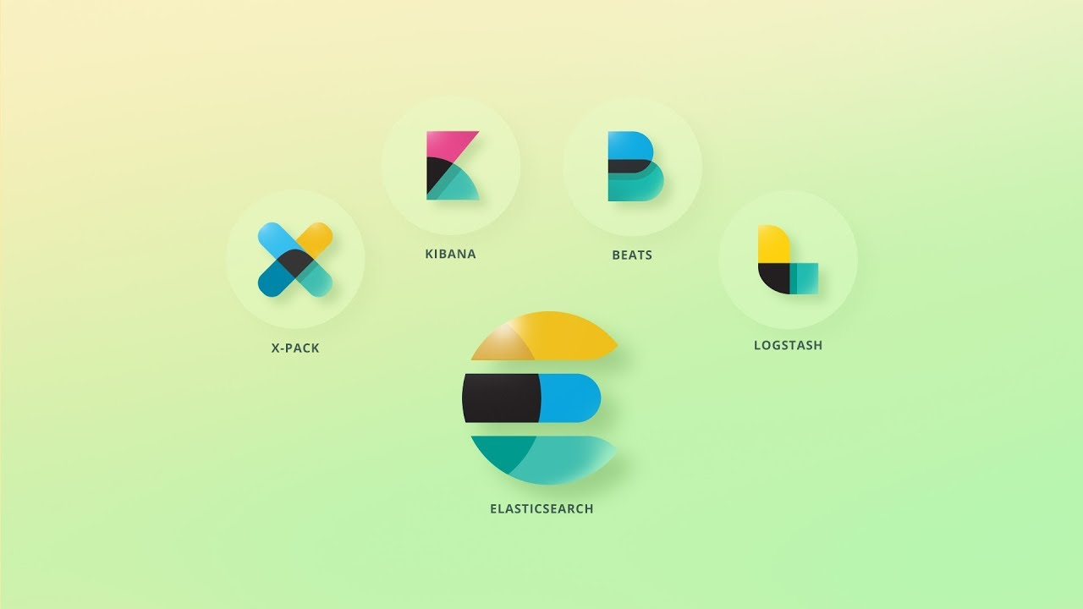
ELASTIC STACK

Slide 8

ELASTIC SEARCH
Let’s Begin “The Game Of Search!”

Slide 9
5 LEVELS
HOW IT HELPS YOU
TOP 3 REASONS WHY
HOW STUFF WORKS
WHO ARE USING
FINAL BONUS LEVEL

Slide 10
LEVEL 1
HOW IT HELPS YOU
TOP 3 REASONS WHY
HOW STUFF WORKS
WHO ARE USING
FINAL BONUS LEVEL
LEVEL 1

Slide 11
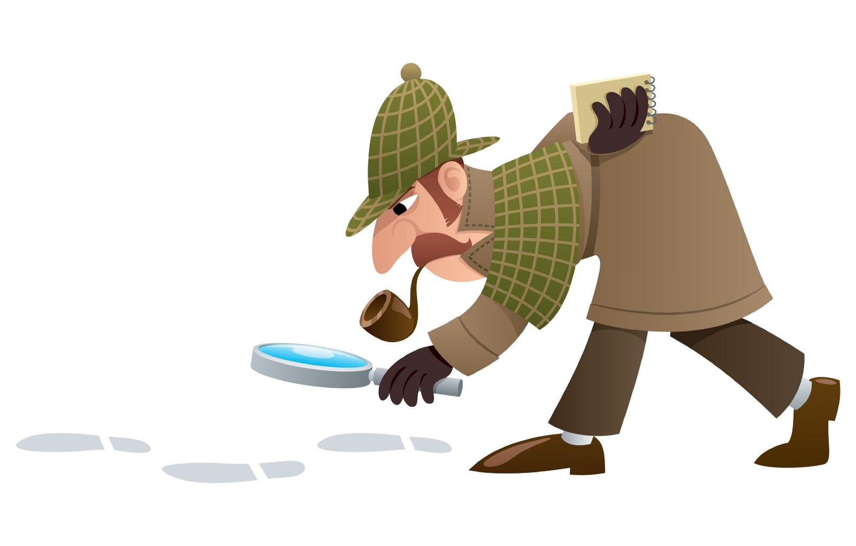
TEXT SEARCH ENGINE
LEVEL 1

Slide 12
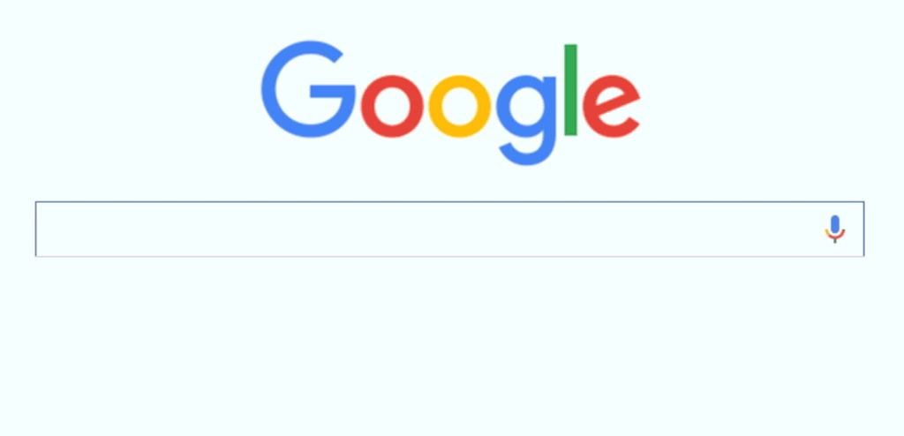
FEATURES
LEVEL 1

Slide 13
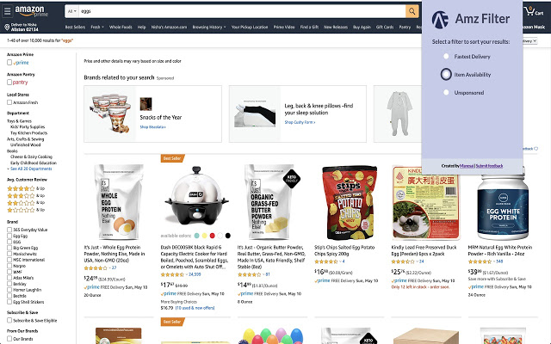
AMAZON
LEVEL 1

Slide 14
LEVEL 2
HOW IT HELPS YOU
TOP 3 REASONS WHY
HOW STUFF WORKS
WHO ARE USING
FINAL BONUS LEVEL
LEVEL 2

Slide 15

R1: ANALYTICS
LEVEL 2

Slide 16
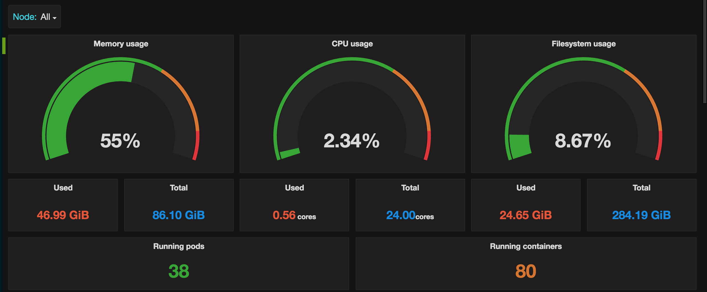
R1: MONITOR
LEVEL 2

Slide 17
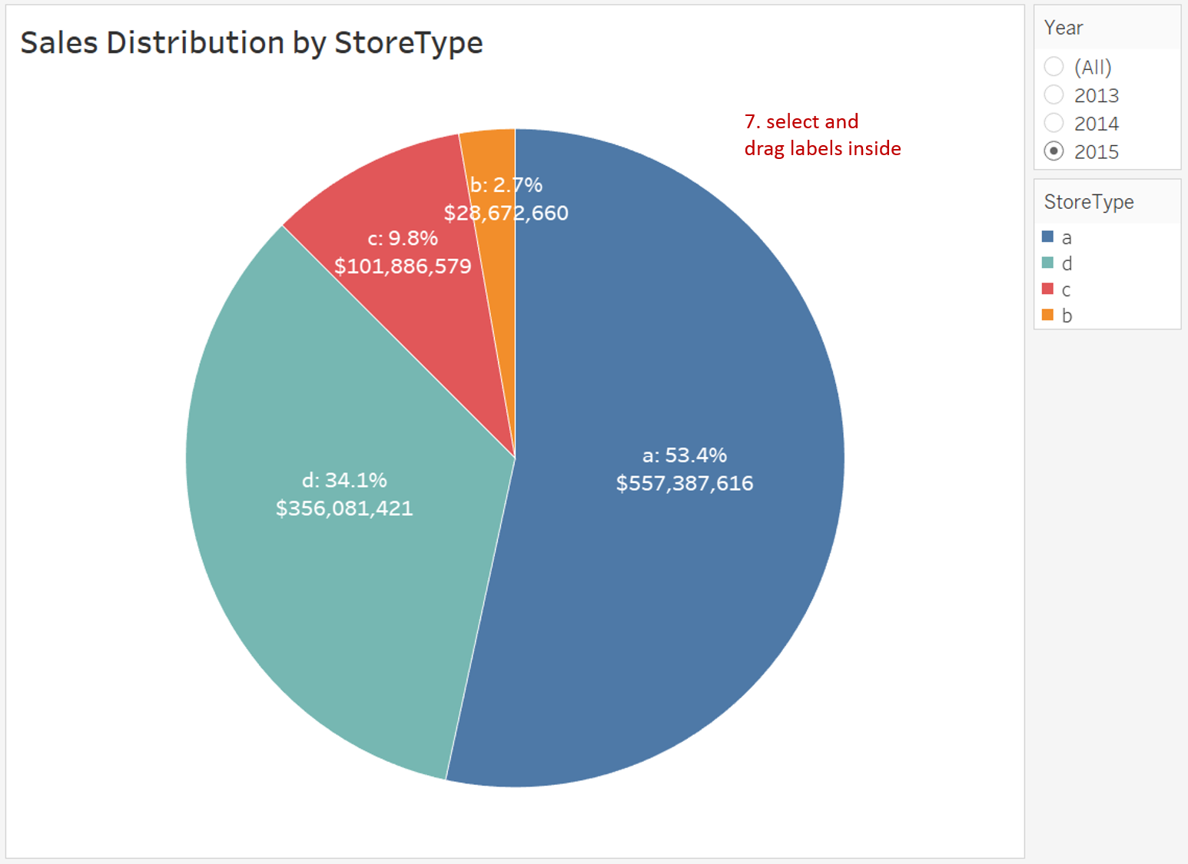
R2: AGGREGATIONS
LEVEL 2

Slide 18
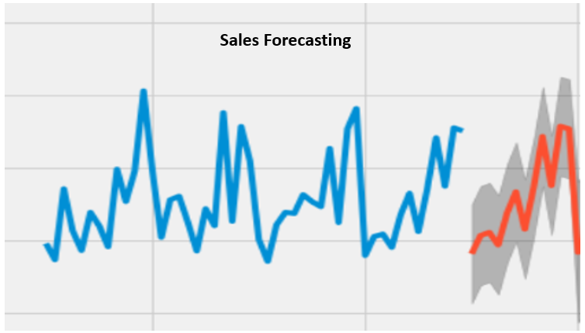
R2: FORECAST
LEVEL 2

Slide 19

R3: ANOMALY DETECTION
LEVEL 2

Slide 20

R3: ALERTS
LEVEL 2

Slide 21
SUMMARY
SEARCHES & FILTERS
ANALYTICS & MONITOR
EVENTING & FORECAST
ANOMALY & ALERTS
LEVEL 2

Slide 22
LEVEL 3
HOW IT HELPS YOU
TOP 3 REASONS WHY
HOW STUFF WORKS
WHO ARE USING
FINAL BONUS LEVEL
LEVEL 3

Slide 23
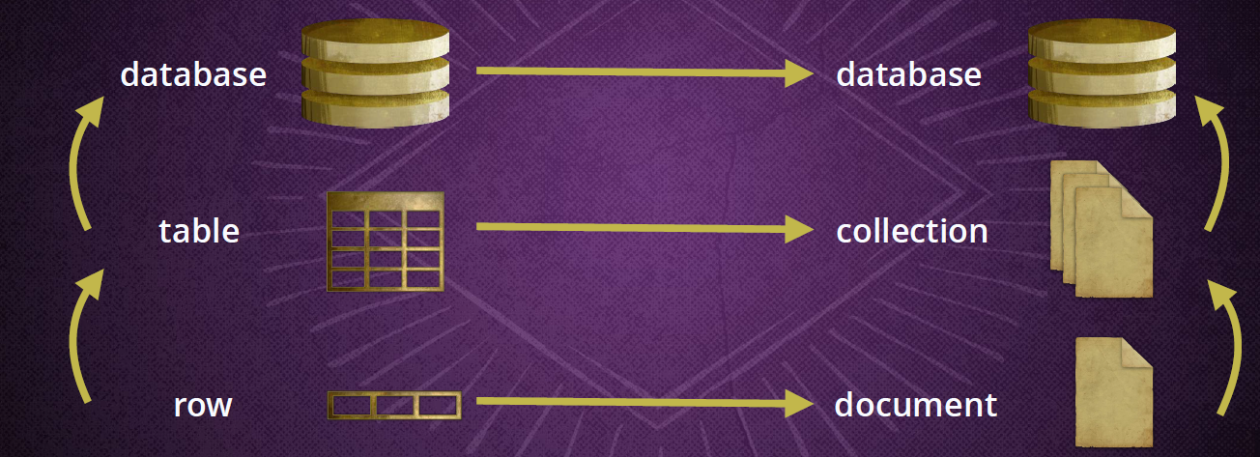
NO-SQL
LEVEL 3

Slide 24
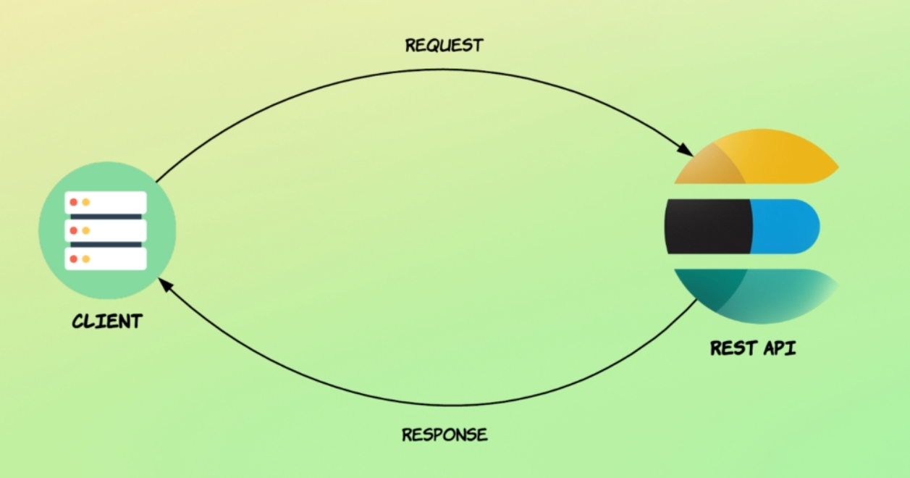
QUERYING
LEVEL 3

Slide 25
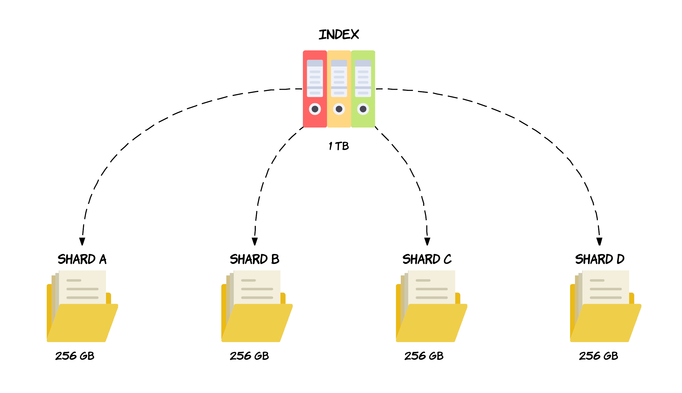
GOING DEEP
LEVEL 3

Slide 26

JUST A SNAP
LEVEL 3

Slide 27
LEVEL 4
HOW IT HELPS YOU
TOP 3 REASONS WHY
HOW STUFF WORKS
WHO ARE USING
FINAL BONUS LEVEL
LEVEL 4

Slide 28
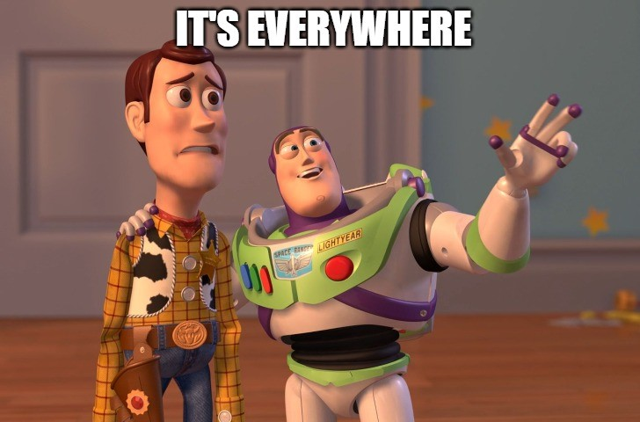
LEVEL 4

Slide 29

LEVEL 4

Slide 30
LEVEL 5
HOW IT HELPS YOU
TOP 3 REASONS WHY
HOW STUFF WORKS
WHO ARE USING
FINAL BONUS LEVEL
LEVEL 5

Slide 31

LEVEL 5
LEVEL 5

Slide 32
ELASTIC STACK

Slide 33

GAME PLAYED BY
GOKUL THIAGARAJAN

